Slide 1
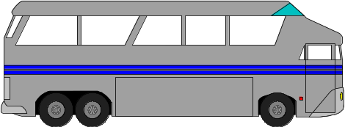
What is a bus?
A Bus Is:
shared communication link
single set of wires used to connect multiple subsystems
A Bus is also a fundamental tool for composing large, complex systems
  systematic means of abstraction
Processor
Input
Control
Memory
Datapath
Output

Slide 2

A word about the bus...
Address Lines
Data Lines
Control Lines

Slide 3
4 Main Categories Of Bus Lines
Data lines
  Carry data from one place to another.
Address lines
  Specify the recipient of data on the bus.
Control lines
  Provide control for the synchronisation and operation of the bus and the modules to which it is connected.
Power lines
  Provide power to various components connected to the bus.

Slide 4
DATA BUS
CPU (ALU, Registers, & Control)
Memory
Input & Output (I/O)
Data Bus
System Bus
Address Bus
Control Bus
Carries data between the CPU and memory or I/O devices
Bi-directional
  “out of” the CPU for write and “into” the CPU for read.
  Width is a key determinant of performance.
    with n data lines an n-bit word can be read written in a single operation.
  Typical sizes: same or multiple of CPU word size . (e.g. 64 bit CPU has 64 or 128 bit data bus)
Signal names - D0, D1, D2, D3, etc.

Slide 5
ADDRESS BUS
CPU (ALU, Registers, & Control)
Memory
Input & Output (I/O)
Data Bus
System Bus
Address Bus
Control Bus
Carries an address (unsigned binary value) from the CPU to Memory or I/O devices
Unidirectional
  The address is always supplied by the CPU
Bus width determines maximum memory capacity of system.
  with m address lines, 2^{m} locations can be addressed.
Typical sizes: 16, 20, 24 lines
Signal names: A0, A1, A2, A3, etc.

Slide 6
CONTROL BUS
CPU (ALU, Registers, & Control)
Memory
Input & Output (I/O)
Data Bus
System Bus
Address Bus
Control Bus
Collection of signals for coordinating CPU activities. CPU uses these pins to control the rest of the system and tell it what it wants to do; control signals are propagated over the system bus.
  Each signal has a unique purpose
Typical sizes: 10-20 lines
Signals are output, input, or bi-directional
Typical signals - /RD (read), /WR (write), CLK (clock), /IRQ (interrupt request), etc.

Slide 7
Multiplexing
In order to avoid vary large buses we have the multiplexed bus.
  Instead of having separate address and data lines, we can have 32 lines for address and data together.
At the start of the bus operation first the lines are used for address; later on, the same lines are used for data.
Bus width can be reduced, but the system becomes slower (for a write, address and data can not be put on the lines simultaneously).

Slide 8
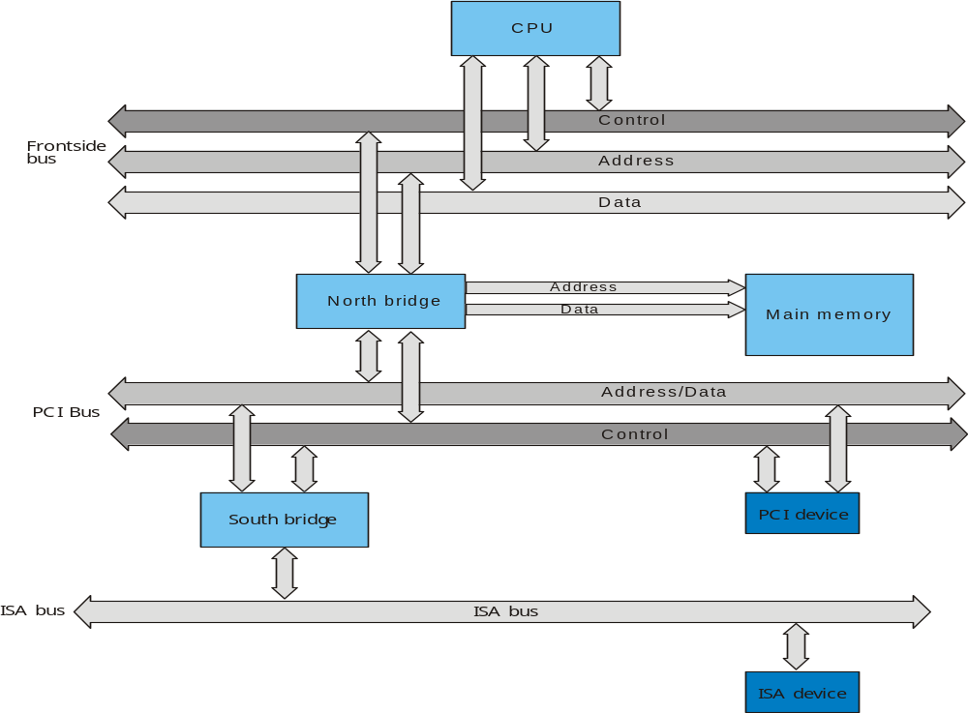
Dedicated vs. Multiplexing Buses
Dedicated
  separate data & address lines
Multiplexed
  shared lines
  Advantage - fewer lines
  Disadvantages
    More complex control
    Ultimate performance

Slide 9
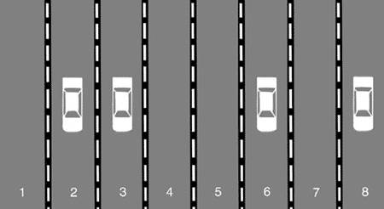
Bandwidth
Speed and width - two properties that affect amount of information transferred.
  Speed - number of clock cycles per second. (GHz)
  Width - number of address and data lines.
    Address - amount of primary data directly addressable
    Data - amount (size) of data transferred at one read/write access

Slide 10
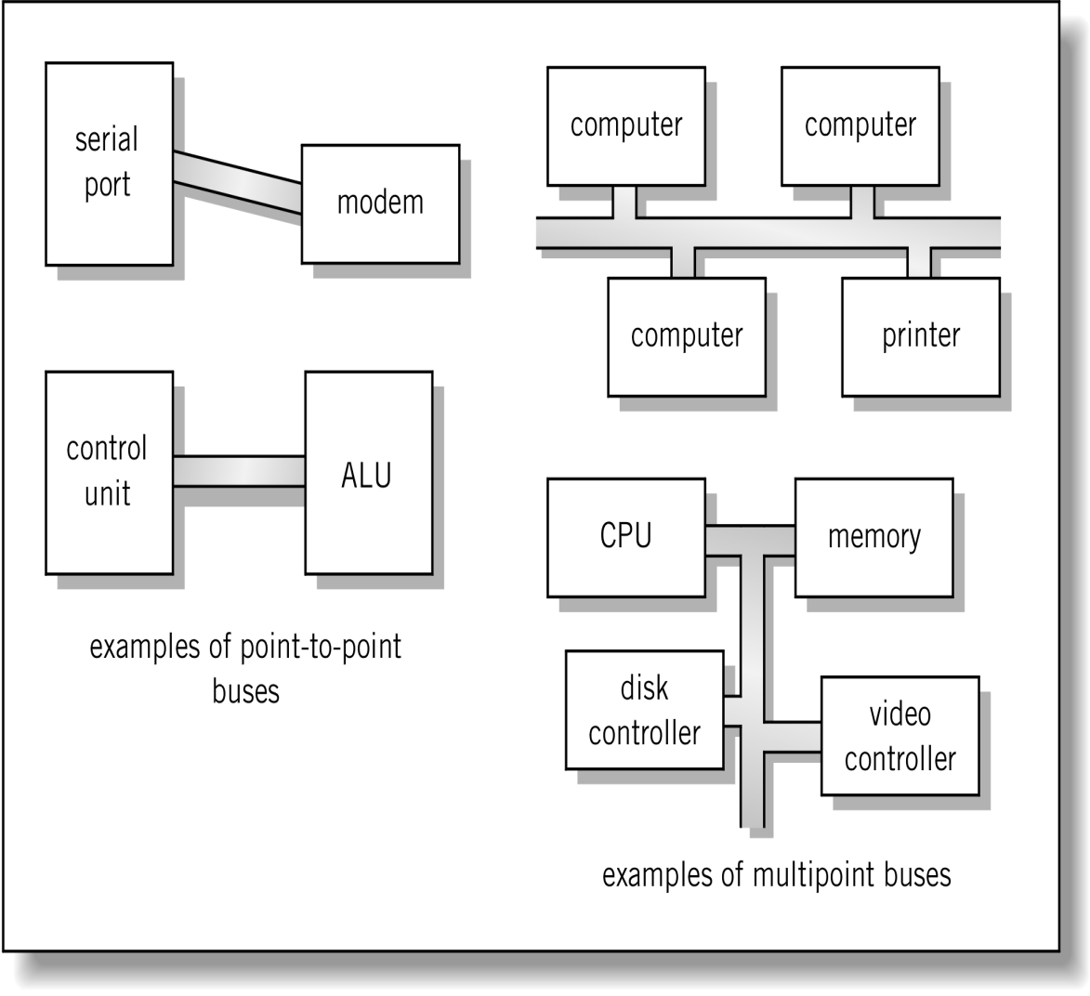
Bus Topologies
Broadcast bus Example: Ethernet
Plug-in device
Point-To-Point Bus
  Carries signals from a specific source to a specific destination
  Do not need addressing signals
  Port
    A point-to-point bus intended to connect to a plug-in device such as a printer
Multipoint/Multidrop/ Broadcast Bus
  Carries signals to several destinations
  Usually requires addressing signals on the bus to identify the addressed destination
  For example: Ethernet.
Shared among multiple devices

Slide 11
Bus Arbitration
Devices connected to a bus can be of two kinds:
  Master:
    is active and can initiate a bus transfer.
  Slave:
    is passive and waits for requests.
Some devices can act both as master and as slave, depending on the circumstances:
  CPU is typically a master.
  The memory acts only like a slave.
  An I/O device usually acts like a slave in interaction with the CPU.
  A co-processor, however, can initiate a transfer of a parameter from the CPU. CPU acts like a slave
  Several devices can perform direct access to the memory, in which case they access the bus like a master.

Slide 12
Bus Arbitration
Control lines: Master initiates requests
Bus
Master
Data lines: Data can go either way
Bus
Slave
What happens if two or more devices want to act simultaneously as masters?
But only one unit at a time can transmit over the bus,
So Bus arbitration is needed.
Bus arbitration schemes usually try to balance:
  Bus priority
    the highest priority device should be serviced first
  Fairness
    even the lowest priority device should never be completely locked out from the bus
Arbitration may be centralized or distributed

Slide 13
Centralized Arbitration
Single hardware device controlling bus access called
  Bus Controller or
  Arbiter
May be part of CPU or separate
Examples:
  PCI and ISA buses use a centralized arbitration scheme.

Slide 14
Distributed Arbitration
Also called Decentralized arbitration:
  no arbiter is needed.
Each module may claim the bus
Control logic on all modules
More bus lines are needed.
Examples:
  SCSI buses use a decentralized scheme.

